Slide 1
Cloud Storage: PUT is the new rename()
Steve Loughran Hortonworks R&D
stevel@hortonworks.com
June 2018
@steveloughran
Notes:
TALK TRACK
Hortonworks Powers the Future of Data: data-in-motion, data-at-rest, and Modern Data Applications.
[NEXT SLIDE]

Slide 2

Speaker & Talk Overview
Hadoop committer; busy on object storage
Why do the cloud stores matter?
Where do the stores stand today?
What new & interesting stuff is there?
Notes:
I'm going to warn there's a bias in this talk to S3. Not out of any personal preference, just because I've been busiest there

Slide 3









Why cloud storage?
Long-lived persistent store for cloud-hosted analytics applications
HDFS Backup/restore
Sharing, data exchange, data collection workflows, …
org.apache.hadoop.fs.FileSystem
hdfs
wasb
s3a
adl
gs
swift
abfs

Slide 4
All examples in Spark 2.3; "S3 landsat CSV" as source
val landsatCsvGZOnS3 = new Path("s3a://landsat-pds/scene_list.gz")
val landsatCsvGZ = new Path("file:///tmp/scene_list.gz")
copyFile(landsatCsvGZOnS3, landsatCsvGZ, conf, false)
val csvSchema = LandsatIO.buildCsvSchema()
val csvDataFrame = LandsatIO.addLandsatColumns(
spark.read.options(LandsatIO.CsvOptions).
schema(csvSchema).csv(landsatCsvGZ.toUri.toString))
val filteredCSV = csvDataFrame.
sample(false, 0.01d).
filter("cloudCover < 15 and year=2014").cache()

Slide 5
Azure wasb:// The ~filesystem for Azure

Slide 6
Azure wasb:// connector shipping and stable
REST API
Tested heavily by Microsoft
Tested heavily by Hortonworks
New! adaptive seek() algorithm
New! more Ranger lockdown
Note: Ranger implemented client-side — needs locked-down clients to work

Slide 7
Upload from file:// to wasb://
val orcDataWasb = new Path(wasb, "orcData")
logDuration("wasb:// ORC") {
filteredCSV.write.
partitionBy("year", "month").
mode(SaveMode.Append).orc(orcDataWasb.toString)
}

Slide 8
Azure Datalake adl://

Slide 9
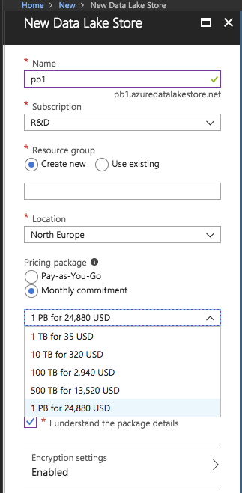
Azure Datalake: Analytics Store
API matches Hadoop APIs 1:1
hadoop-azuredatalake JAR
Runs on YARN
Authenticates via OAuth2
Ongoing : resilience & supportability
Notes:
If there's a fault with the adl:// connector, it's usually "error(null"). This can mean anything, including "you don't have your proxy settings and an HTML page is coming back, which confuses our JSON parser"…the kind or problem which surface in the field.
Need also to highlight possibility that it's caching things client side for perf. If true, risk of consistency.

Slide 10
Upload data to adl:// as ORC
val orcDataAdl = new Path(adl, "orcData")
logDuration("write to ADL ORC") {
filteredCSV.write.
partitionBy("year", "month").
mode(SaveMode.Append).format("orc").save(orcDataAdl.toString)
}

Slide 11
Azure Data Lake Storage Gen 2 (Preview)
Bigger, better, faster, lower cost,
In Beta; live 2H18

Slide 12
abfs:// is the connector
New REST API
HADOOP-15407: add the hadoop connector
Store and client to succeed wasb:// and adl://
Old endpoints to remain; wasb:// will continue to work.
abfs:// connector being developed with store; usual stabilization process
Notes:
A key thing to note here is that the Hadoop connector dev has been going on in sync with thee store service, with full stack regression testing going on. This increases its

Slide 13
abfs demo:
val orcDataAbfs = new Path(abfs, "orcData")
logDuration("write to ABFS ORC") {
filteredCSV.write.
partitionBy("year", "month").
mode(SaveMode.Append).format("orc").
save(orcDataAbfs.toString)
}

Slide 14
Amazon S3: Use with Care: inconsistency is its flaw

Slide 15
S3Guard: High Performance & Consistent Metadata for S3
Uses DynamoDB for a consistent view
Ensures subsequent operations see new files
Filters out recently deleted files
Can speed up listStatus() & getFileStatus() calls
Stops rename() (and so job commit) missing files
Prevents data loss during Hadoop, Hive, Spark queries

Slide 16

S3Guard: fast consistent metadata via Dynamo DB
HEAD part-00
200
s01
s02
00
01
DELETE part-00
200
00
00
s03
s04
HEAD part-00 404
01
00
01
PUT part-00
200
Notes:
Details about out-of-band, and source of truth etc.

Slide 17
S3Guard: bind a bucket to a store, initialize the table, use
<property>
<name>fs.s3a.bucket.hwdev-steve-ireland-new.metadatastore.impl</name>
<value>org.apache.hadoop.fs.s3a.s3guard.DynamoDBMetadataStore</value>
</property>
hadoop s3guard init -read 50 -write 50 s3a://hwdev-steve-ireland-new
…
Metadata Store Diagnostics:
ARN=arn:aws:dynamodb:eu-west-1:980678866538:table/hwdev-steve-ireland-new
description=S3Guard metadata store in DynamoDB
name=hwdev-steve-ireland-new
read-capacity=20
region=eu-west-1
retryPolicy=ExponentialBackoffRetry(maxRetries=9, sleepTime=100 MILLISECONDS)
size=15497
status=ACTIVE

Slide 18
Next: the commit problem
/
Task commit: rename to job directory
Job commit: rename to final directory
Filesystems & most stores: O(directories)
S3: COPY operation @6/10 MB/s
Without S3Guard, risk of loss
work
_temporary
part-01
attempt_123
part-00
part-01
rename("/work/temporary/attempt_123/part-01", "/work/")

Slide 19
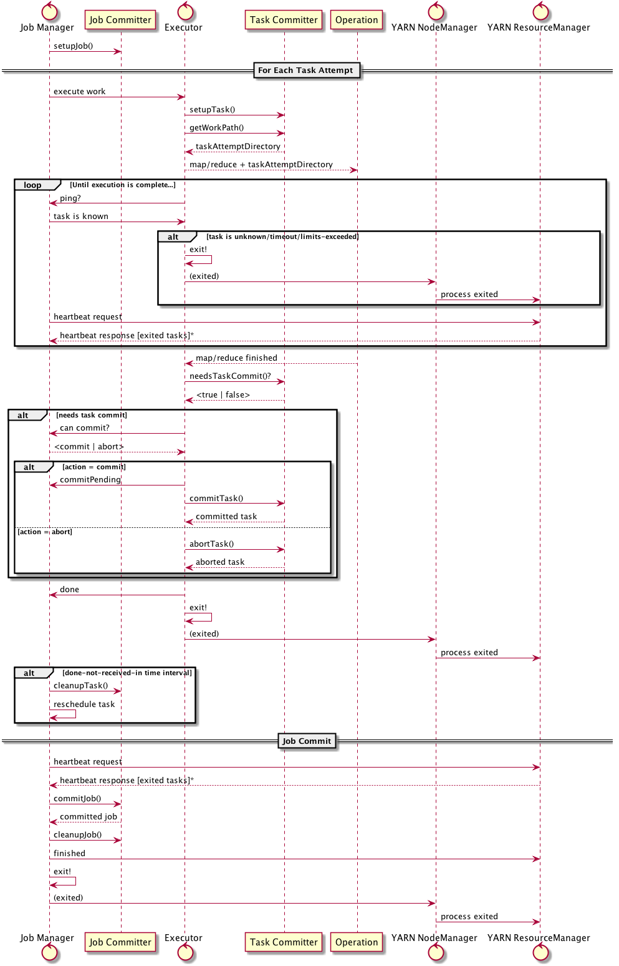
MR Commit Protocol

Slide 20
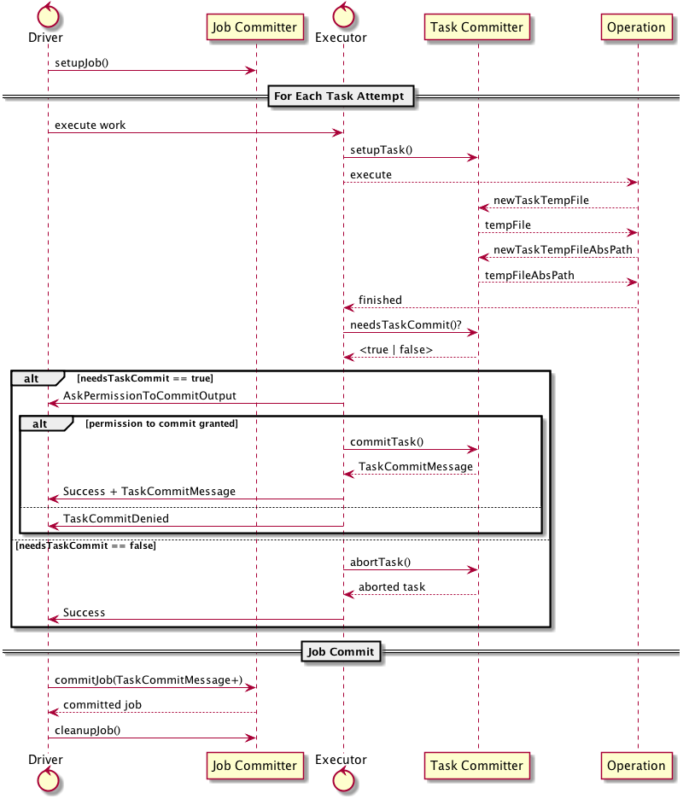
Spark Commit Protocol

Slide 21
PUT replaces rename()
Task 00:
put00 = POST "Multipart Upload" /work/part00
s01
s02
POST "Block" put00, /work/part00, data
00
01
00
Task 01:
00
put01 = POST "Multipart Upload" /work/part01
POST "Block" put01, /work/part01, data
s03
s04
01
00
01
Job Commit
01
POST "Complete" put00, /work/part00
POST "Complete" put01, /work/part01
Notes:
Details about out-of-band, and source of truth etc.

Slide 22
S3A Committers + Spark binding
spark.sql.sources.commitProtocolClass
org.apache.spark.internal.io.cloud.PathOutputCommitProtocol
spark.sql.parquet.output.committer.class
org.apache.spark.internal.io.cloud.BindingParquetOutputCommitter
spark.hadoop.fs.s3a.committer.name staging
spark.hadoop.fs.s3a.committer.staging.conflict-mode replace
Also
spark.hadoop.fs.s3a.committer.name partitioned
spark.hadoop.fs.s3a.committer.name magic

Slide 23
S3A Committer writing ORC and Parquet to S3A
val orcDataS3 = new Path(ireland, "orcData")
orcWasbDataframe.write.
partitionBy("year", "month").
mode(SaveMode.Append).orc(orcDataS3.toString)
val orcS3DF = spark.read.orc(orcData.toString).as[LandsatImage]
val parquetS3 = new Path(ireland, "parquetData")
orcDF.write.
partitionBy("year", "month").
mode(SaveMode.Append).parquet(parquetData.toString)
cat(new Path(parquetData, "_SUCCESS"))

Slide 24
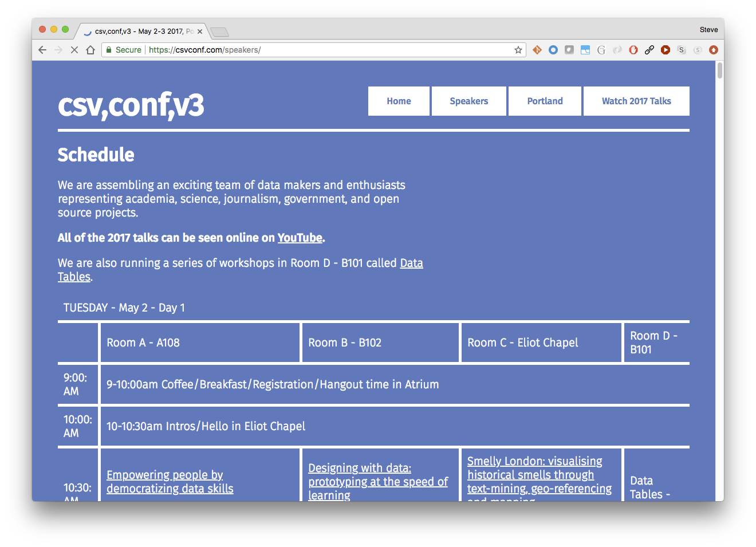
CSV files: the "Dark Matter" of data

Slide 25
CSV: less a format, more a mess
Commas vs tabs? Mixed?
Single/double/no quotes. Escaping?
Encoding?
Schema? At best: header
missing columns?
NULL?
Numbers?
Date and time?
Compression?
CSV injection attacks (cells with = as first char) [Excel, google docs]

Slide 26
S3 Select: SQL Queries on CSV/JSON In S3 Itself
SQL Select issued when opening a file to read
Filter rows from WHERE clause
Project subset of columns
Use CSV header for column names
Cost of GET as normal
Save on bandwidth

Slide 27
S3 SELECT against the landsat index dataset
# examine data
hadoop s3guard select -header use -compression gzip \
-limit 10 \
s3a://landsat-pds/scene_list.gz \
"SELECT s.entityId FROM S3OBJECT s WHERE s.cloudCover = '0.0'"
# copy subset of data from S3 to ADL
hadoop s3guard select -header use -compression gzip \
-out adl://steveleu.azuredatalakestore.net/landsat.csv \
s3a://landsat-pds/scene_list.gz \
"SELECT * FROM S3OBJECT s WHERE s.cloudCover = '0.0'"

Slide 28
DEMO: remote client, 300MB /1M rows of AWS landsat index
time hadoop fs -text $LANDSATGZ | grep ",0.0,"
=> 44s
// filter in the select
time hadoop s3guard select -header use -compression gzip $LANDSATGZ \
"SELECT * from S3OBJECT s where s.cloudCover = '0.0'"
=> 12.20s
// select and project
time hadoop s3guard select -header use -compression gzip $LANDSATGZ \
"SELECT s.entityId FROM S3OBJECT s WHERE s.cloudCover = '0.0' LIMIT 100"
=> 4s

Slide 29
S3 Select Transcoding
Input
JSON-per-row format
UTF-8 CSV with configured separator, quote policy, optional header
Raw or .gz
Output
JSON-per-row format
UTF-8 CSV with configured separator, quote policy, NO HEADER
loss of CSV header hurts Spark CSV Schema inference

Slide 30
Integration: Work in Progress. Hadoop 3.2?
Later AWS SDK JAR, upgrades "mildly stressful"
new S3AFileSystem.select(path, expression) method
Filesystem config options for: compression, separator, quotes
TODO: open() call which takes optional & mandatory properties (HADOOP-15229)
TODO: adoption by Hive, Spark, …

Slide 31
Google Cloud Storage

Slide 32
Google Cloud: Increasing use drives storage
More users (TensorFlow motivator)
More tests (i.e. GCS team using ASF test suites, ...)
Google starting to contribute optimizations back to the OSS projects (e.g. HDFS-13056 for exposing consistent checksums
+Cloud BigTable offers HBase APIs
Attend: Running Apache Hadoop on the Google Cloud Platform Grand Ballroom 220A, Wednesday, 16:40

Slide 33
What else?

Slide 34
Security & Encryption
Enable everywhere: transparent encryption at rest
Customer-key-managed encryption available — may have cost/performance impact
Key-with-request encryption: usable with care
Client side encryption. Troublesome
Permissions:
ADL, GCS: permissions managed in store
WASB: Ranger checks in connector: needs locked-down client
S3: IAM Policies (server side, limited syntax, minimal hadoop support)

Slide 35
DistCP++
Old HDFS ⟺ HDFS
New: HDFS ⟺ cloud, container ⟺ container, cloud ⟺ cloud,
We are going to have to evolve DistCP for this
New: Cloud-optimized -delete option
TODO: stop the rename().
Need a story for incremental updates across stores
Notes:
I seem to be getting bug reports related to distCP and clouds assigned to me. This is probably a metric of (a) rising popularity and (b) performance/functionality issues
I've got a quick PoC of actually using Spark to schedule the work: you can do a basic distcp successor in 200 LoC by ignoring all the existing options and throttling. Tempting to use as a basis for a CloudCP, but as distcp is often used as a library for other apps, it fails to meet some core deployment needs.
More likely: extend distcp with ability to save & restore (src, dest) checksums and then compare these on the next incremental update.

Slide 36
https://github.com/HotelsDotCom/circus-train

Slide 37
How do they compare? (excluding abfs)
 | AWS S3 | Azure WASB | Azure ADL | Google GCS
Can run HBase (i.e. "filesystem") | No | Yes | No | No
Safe destination of work | With S3Guard or EMRFS consistent view | Yes | Yes | Yes
Fast destination of work | With S3A Committers | Yes | Yes | Yes
Security | IAM Roles | Ranger in locked-down client | Ranger | ACLs
Encryption | Server-side; can use AWS KMS | Yes, keys in Key Vault | Yes, keys in Key Vault | always; can supply key with IO request
Notes:
Choosing which cloud infrastructure to use is something which tends to choose what your storage option is going to be: AWS and GCS dictate the options. Azure is interesting in that there are two: WASB vs ADL, and a successor coming

Slide 38
To Conclude
All cloud infrastructures have object stores we can use
Width and depth of product offerings increasing
Azure teams most engaged with the Hadoop project
S3 is the least suited as a destination, but we have solutions there.
Cloud Storage evolving: S3 Select one notable example
Data analytics is a key cloud workload; everything is adapting

Slide 39
Questions?
stevel@hortonworks.com

Slide 40
Thank you
stevel@hortonworks.com

Slide 41
Code used in this talk
Hadoop trunk + HADOOP-15407 (abfs://) and HADOOP-15364 (S3 Select) patches
Spark master with SPARK-23977 PR applied
Hortonworks Spark Cloud integration module various utils + schema for Landsat https://github.com/hortonworks-spark/cloud-integration
Cloudstore: diagnostics & utils https://github.com/steveloughran/cloudstore

